Slide 1

FROM THE PAST TO ETERNITY
Long Term Preservation In a Distributed Environment
The Approach of the Hungarian Comprehensive Library Platform
Miklós Lendvay
National Széchényi Library Budapest
25th June, 2018

Slide 2
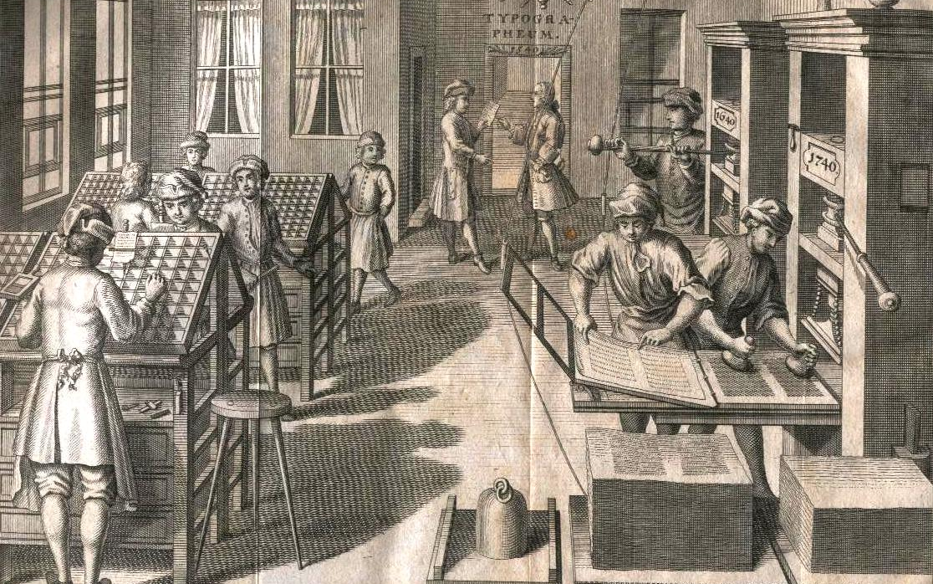
Collect the wisdom of a community
Digest it
Promote it
to a restricted / wider audience
Preserve it for an infinite time

Slide 3
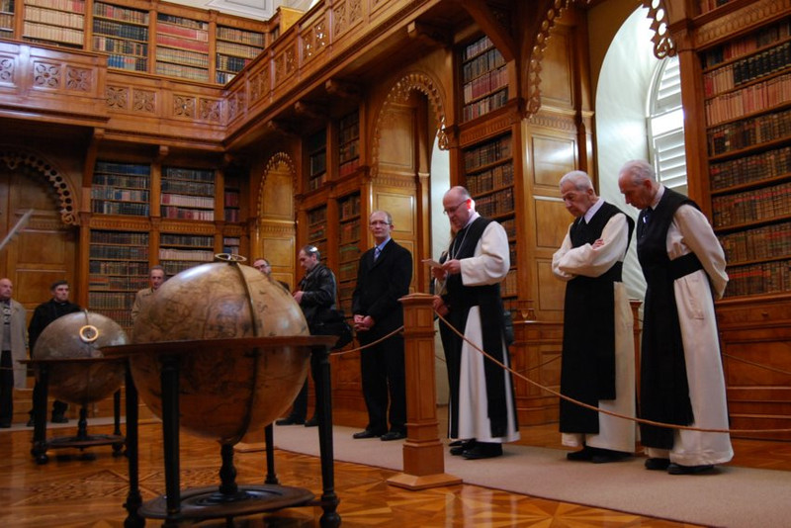
INFLUENCE
POWER
PRIVILEGED
INFORMATION
STRICTLY PROTECTED

Slide 4
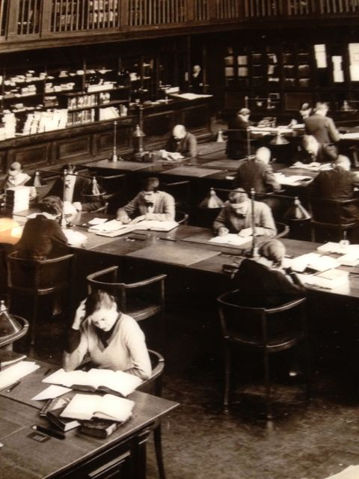
Revolution of ACCESS
SHARE

Slide 5
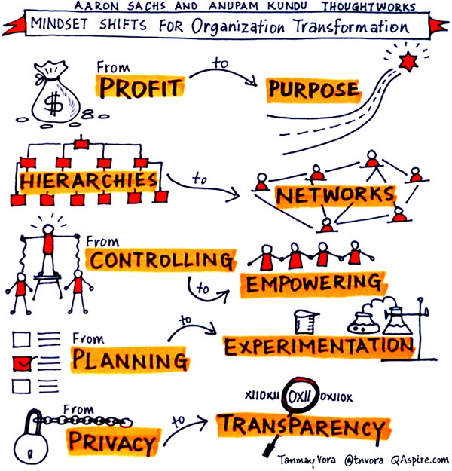

Slide 6
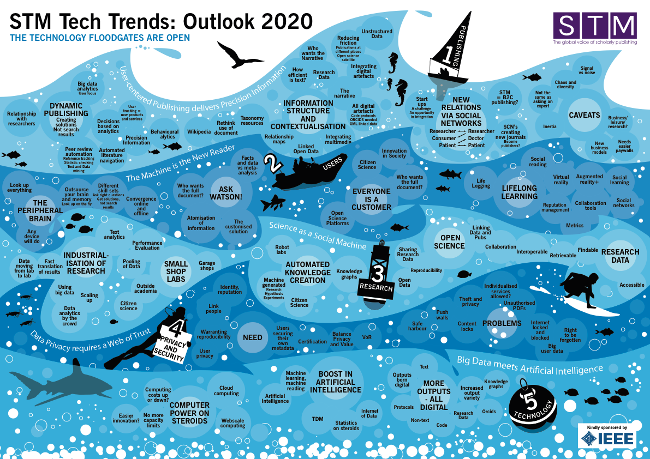
Dynamic publishing
Information structure
and contextualisation
New relations
via social networks
Automated knowledge creation
Boost in
artificial intelligence

Slide 7
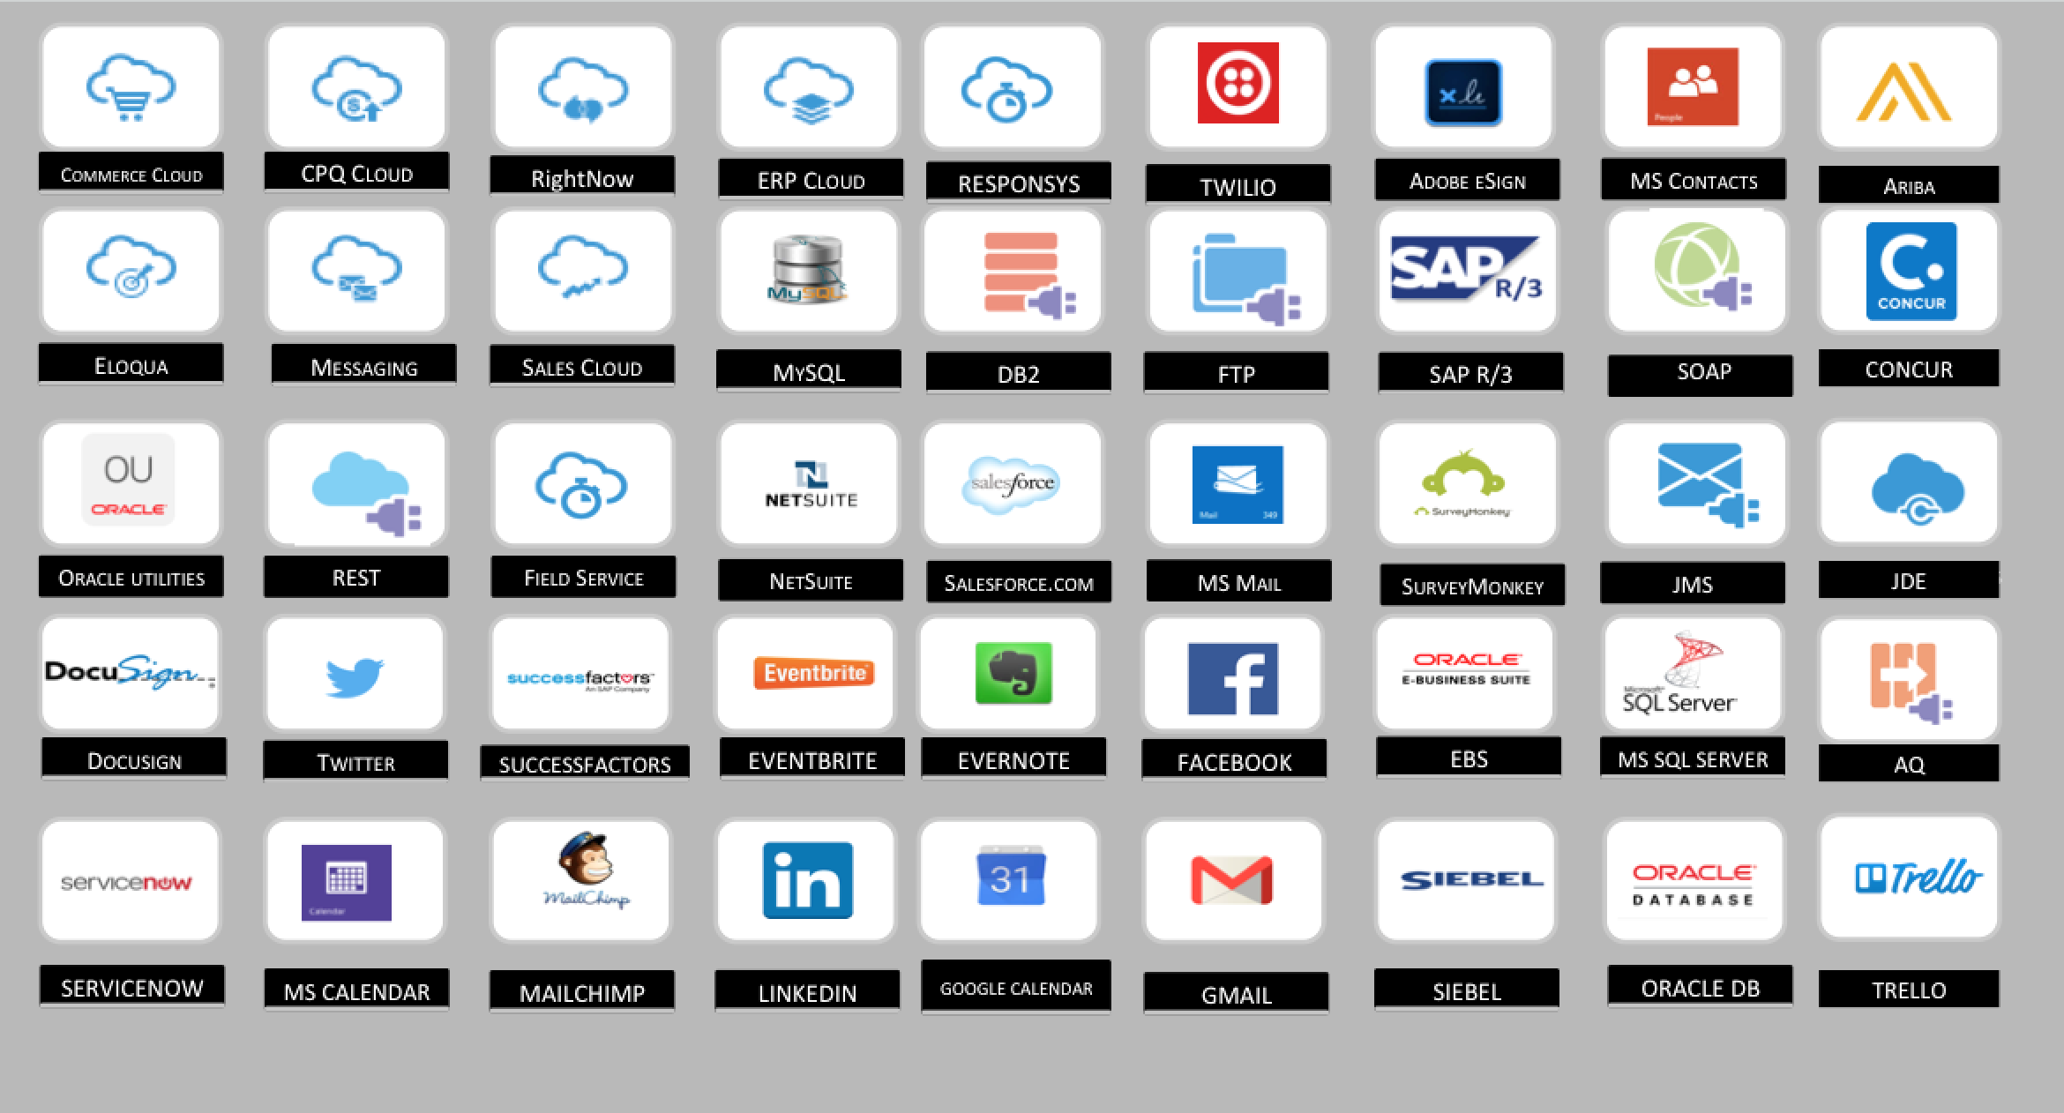

Slide 8

Microservices, modularity, flexibility

Slide 9
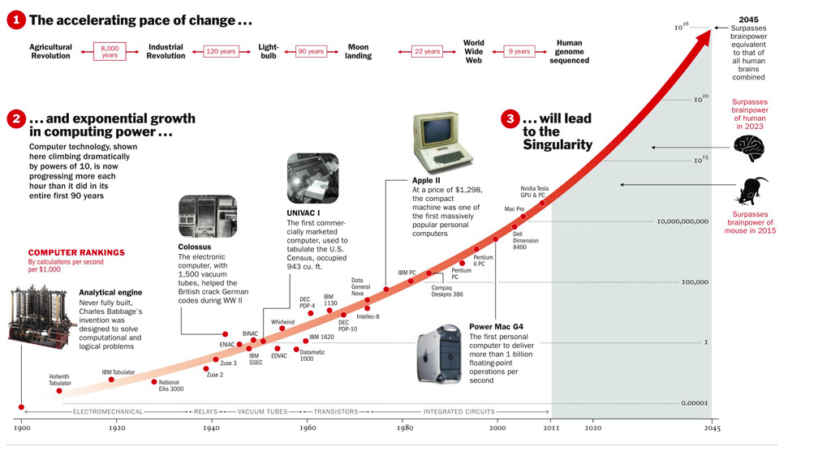
Growth of Data
Unstructured
Machine Generated
Source: TIME

Slide 10
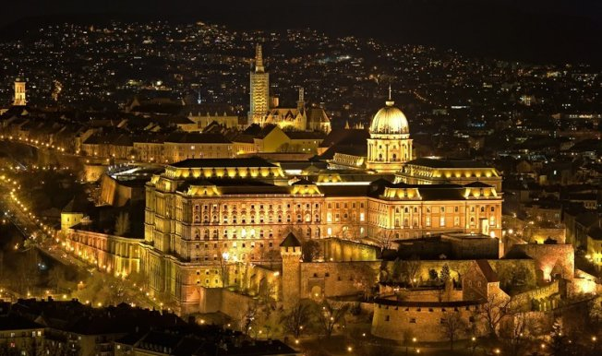
HERE
WE HAVE
EVERYTHING

Slide 11
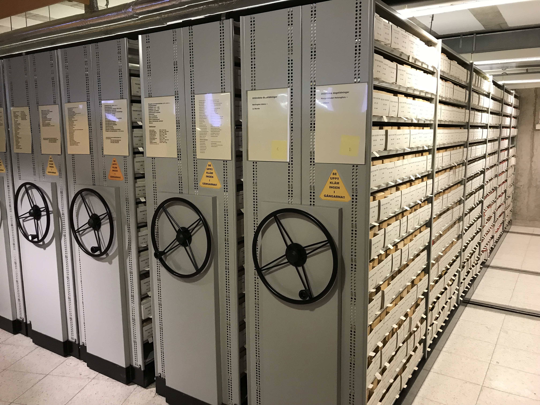
CENTRAL SHARED FUNCTIONS
NAMESPACES
DIGITAL COLLECTIONS
QUALITY LEVELS
BIBLIOGRAPHY MANAGEMENT
GATE
USER MANAGEMENT AUTHENTICATION AND ACCESS RIGHTS
COPYRIGHT INFORMATION

Slide 12
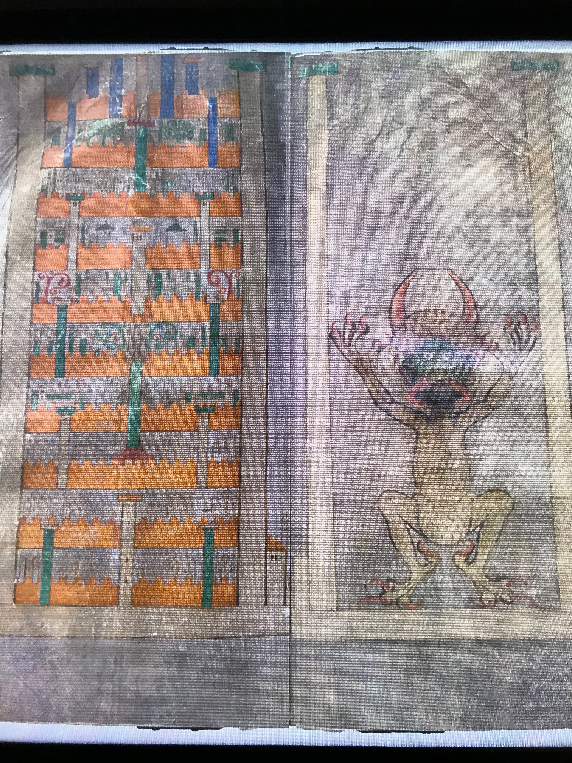
CENTRAL SHARED FUNCTIONS
WORKFLOW
WEB-ARCHIVING
COMMON CATALOGUE INTERLIBRARY LOAN
DIGITISATION ACTIVITIES
LONG TERM PRESERVATION
PARAMETER-DRIVEN INDIVIDUAL SKIN
DIGITISATION REGISTRY

Slide 13
Plan of the National Library Platform
AND EVER
EVOLVING SYSTEM!

Slide 14
Ways Of Possible Cooperation
Shared software / the option to move in
Multitenant environment, private data per institution
Central database,
Upload of data or real time data synchronisation
Interface / connectors
Institutional, local databases
Supporters outside of institutions; citizen science,
authors, researchers, publishers, volunteers, crowdsourcing etc.

Slide 15
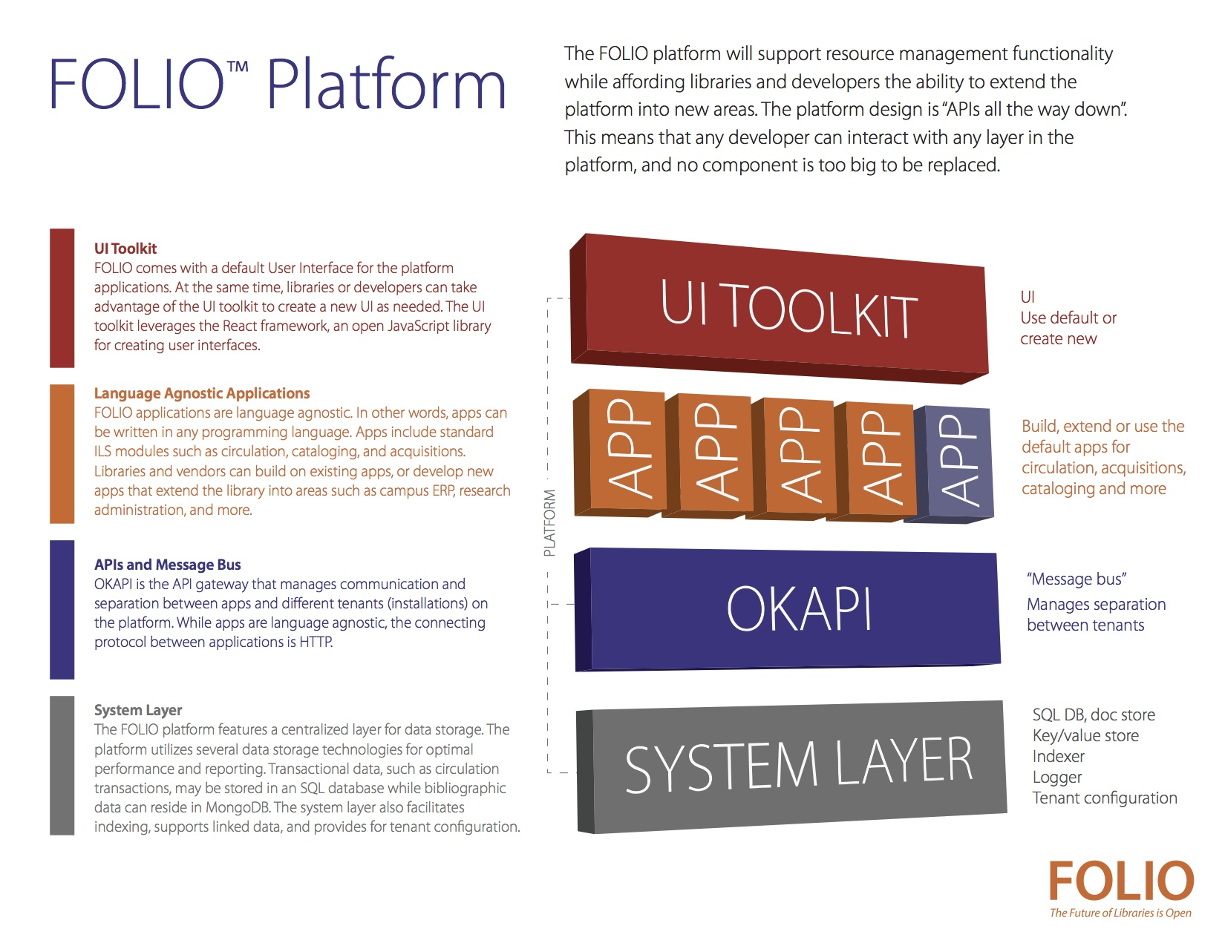

Slide 16
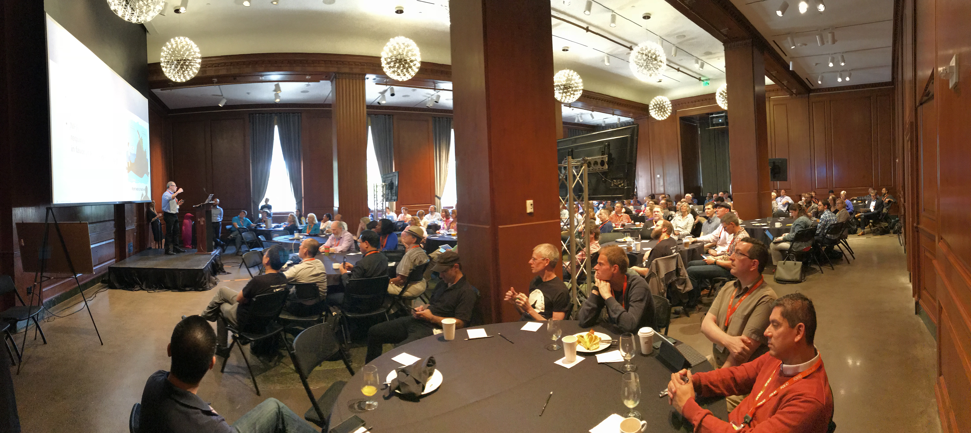
  WolfCon – World Of Open Libraries Conference

Slide 17
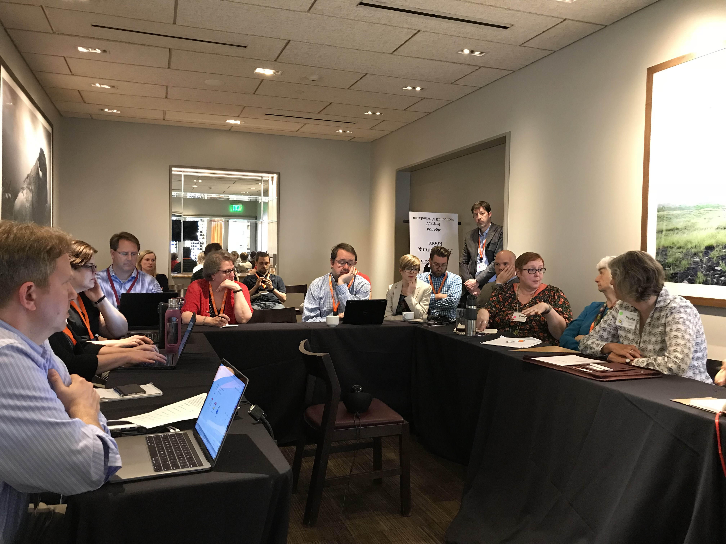
  Early Implementers Special Interest Group (SIG)

Slide 18
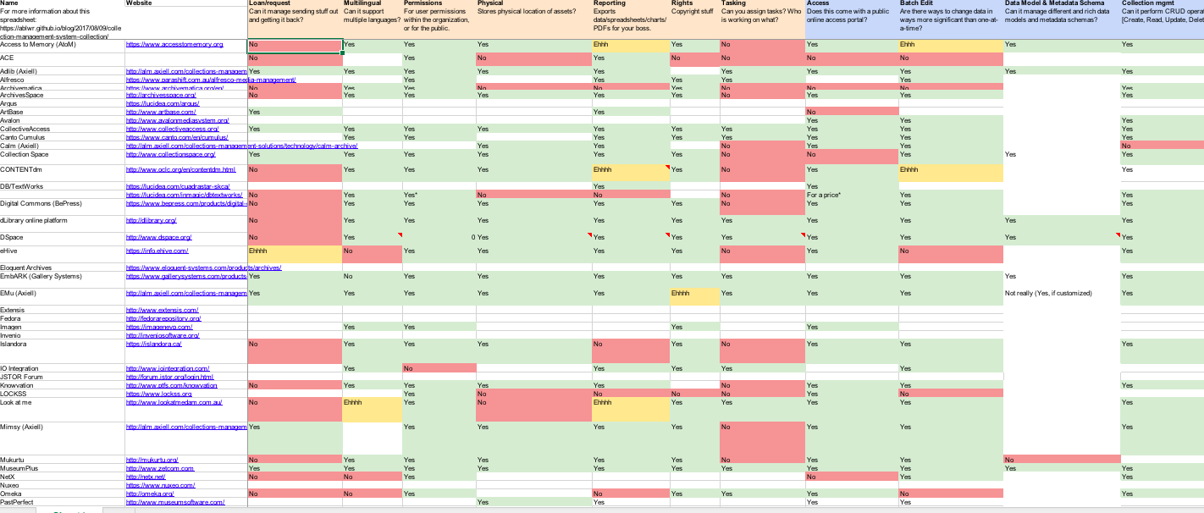
Inventory of Special Collections and Archives Working Group, FOLIO
Source: FOLIO working group, Collection Management System

Slide 19
Inventory of Special Collections and Archives Working Group, FOLIO
Circulation | Fulfilment | Multilanguage | Access rights | Preservation of digital objects
Reporting | Copyright information | Task/ workflow management | Access regulation | Batch processing
Datamodell | Metadata Schema | Collection management | Digital asset management | Upload
Long Term Preservation of Digital Content | Open Source | Import / Export | API | Community support
Source: FOLIO working group, Collection Management System

Slide 20
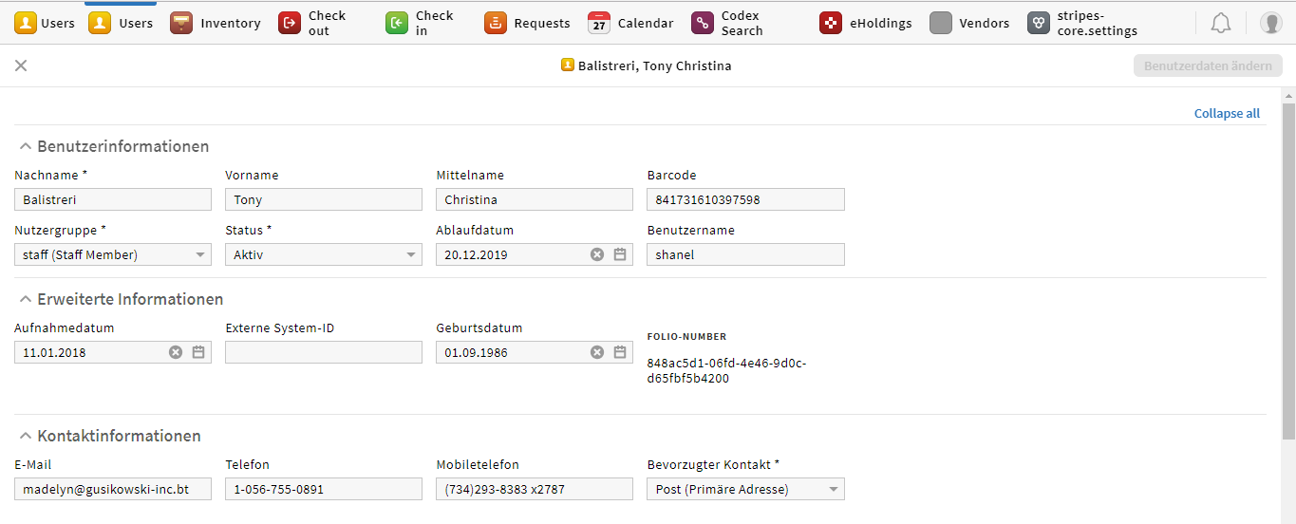
  FOLIO Features Across All Modules
  Locale-Driven Display Language
Locale =
German - Germany
Notes:
Of course the locale also determines the display language. FOLIO has very few translations at this point, but if you select the German - Germany locale, you’ll see that the Users app has been translated. So the system is internationalized (ready for translations) but not yet localized.

Slide 21
  Metadata Management In FOLIO
Inventory UI
eHoldings UI
Codex Search UI
BFCat UI
mod-inventory
mod-kb-ebsco
mod-codex
mod-bibframe
EKB
inventory-storage
bibframe-storage

Slide 22
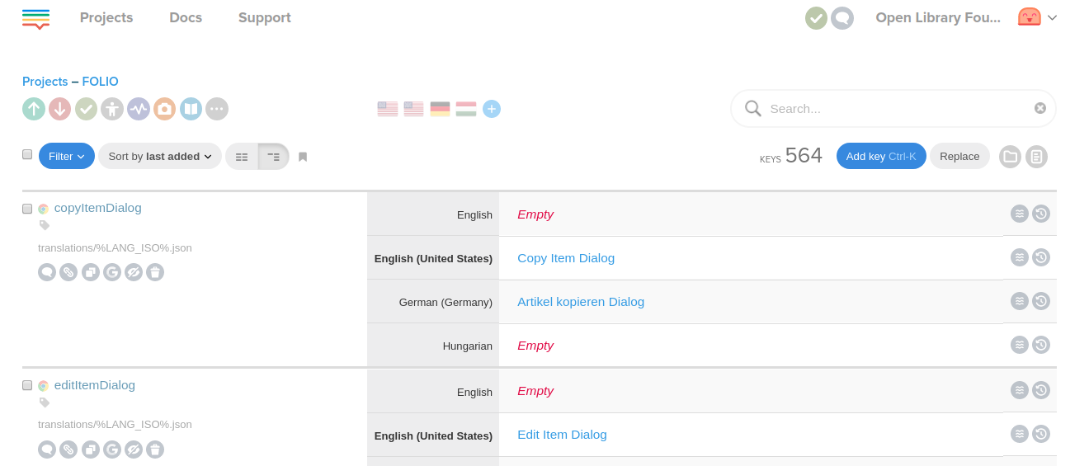
  FOLIO Translation Management Tool
Lokalise provides a UI for FOLIO translation plus lots of cool features such as the ability to crowdsource translations, machine translation capabilities, duplicate finder, proofreading etc.

Slide 23
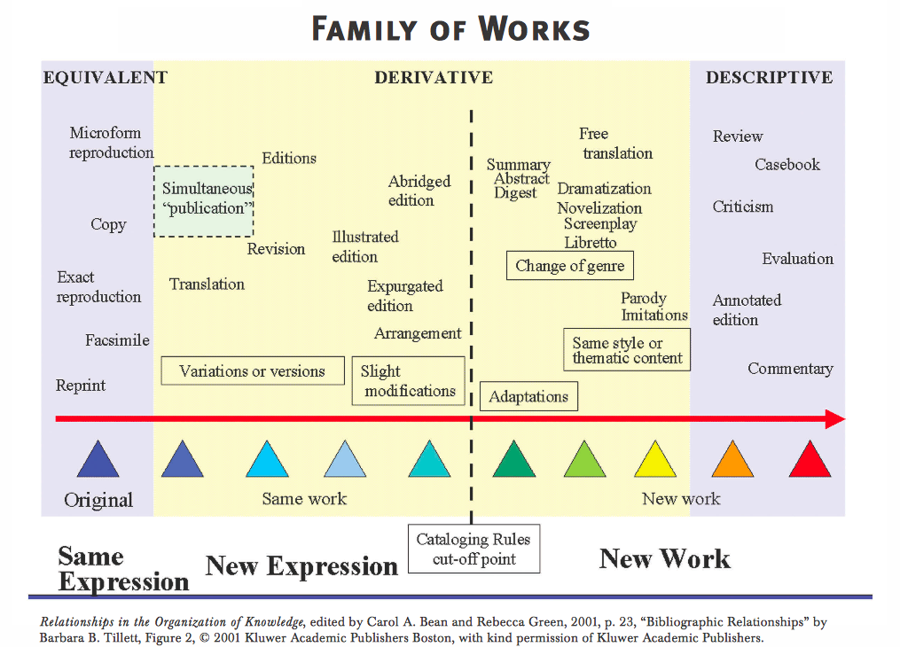

Slide 24
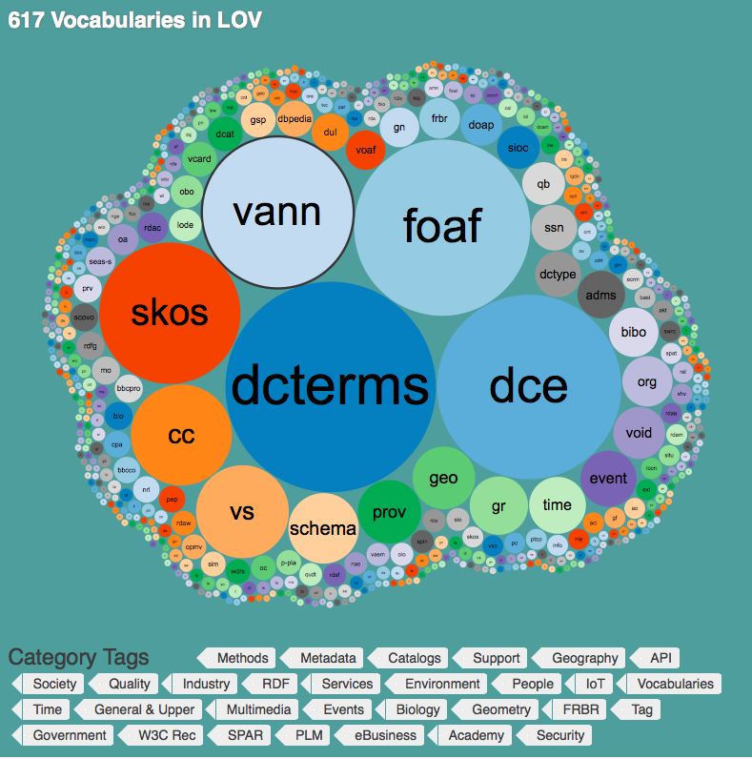
OPEN LINKED DATA

Slide 25
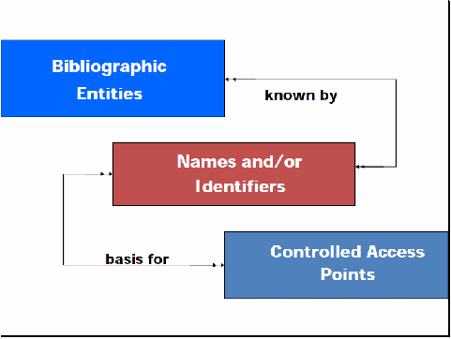

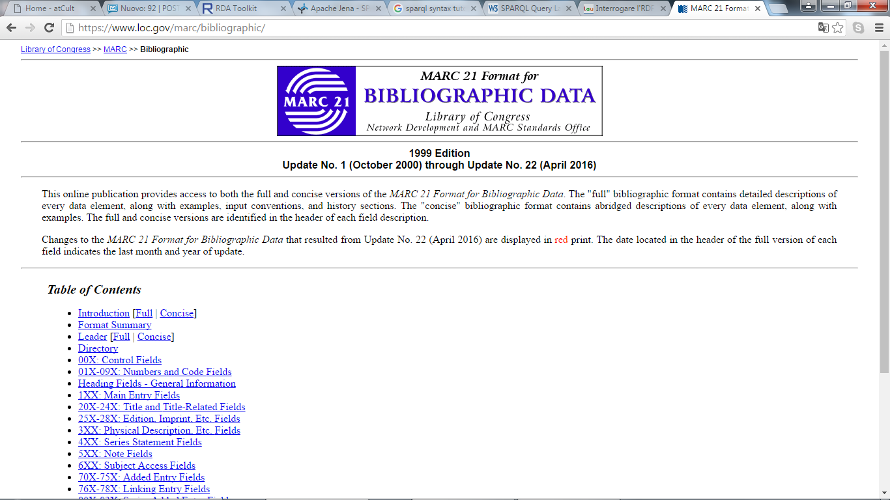
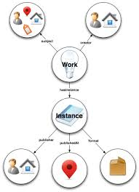
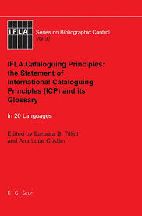
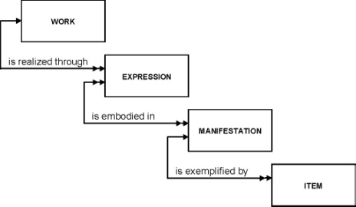
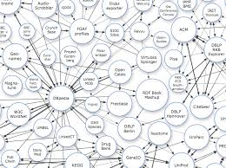
  Identification, Linking of Data
Resource Description and Access
Functional Requirements for Authority Data
BIBFRAME
Functional Requirements for Bibliographic Records
Semantic web / Linked data
International Cataloguing Principles
Source: Tiziana Possemato, @cult
Notes:
25

Slide 26

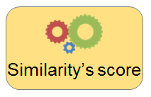
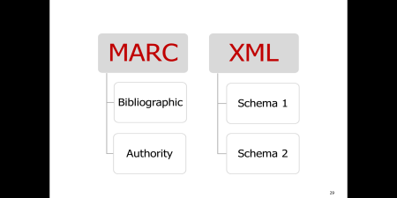
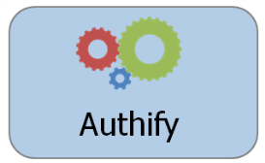
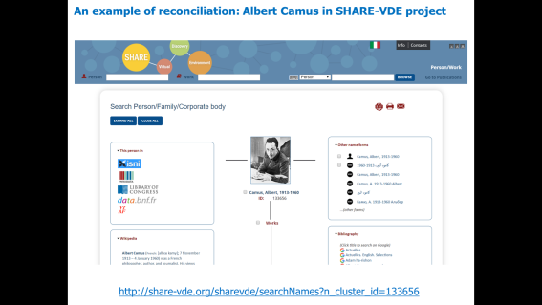
  The Share-VDE process
Publishers
Works
Person
Data enrichment (URIs)
Data creation
(RDF or MARC or ……)
Database of relationships
N3
N2
N1
Entity detection
Automatic enrichment
Reconciliation / Cluster
Knowledge base of clusters
Lodify
Dump
db
APIs
RDF/Bibframe dataset
External sources
Source: Tiziana Possemato, @cult
SHARE-VDE Portal

Slide 27



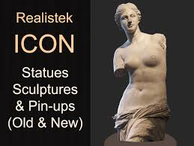






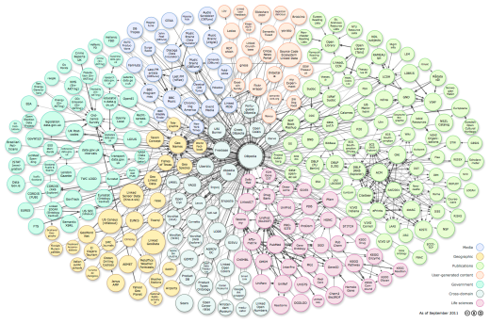




The conversion process from any format to RDF
  Lodify: the evolution of Aliada
  for BIBFRAME conversion
BROWSERS (GOOGLE)
RESOURCES
METADATA CREATORS (Librarians, curators)
ALIADA
IT COMPANIES
Library Management System (ILS)
Museum Collection Management System (MMS)
Content Management System (CMS)
OTHER PUBLIC AND CULTURAL INSTITUTIONS
LINKED DATA CLOUD
http://lod-cloud.net/

Slide 28






Injection services (massive)
Injection services (massive)
CLUSTERS
KNOWLEDGE
BASE
Cluster search services
Injection services (single cluster)
API
GET
PUT
/names
/corporates
/cluster/new
/works
/people
/relatorTerms
Source: Tiziana Possemato, @cult
Notes:
In addition to the two mentioned TOOLS a central component is the KNOWLEDGE BASE that provides:
- the GET service to retrieve the cluster data
- the PUT service to create new clusters

Slide 29
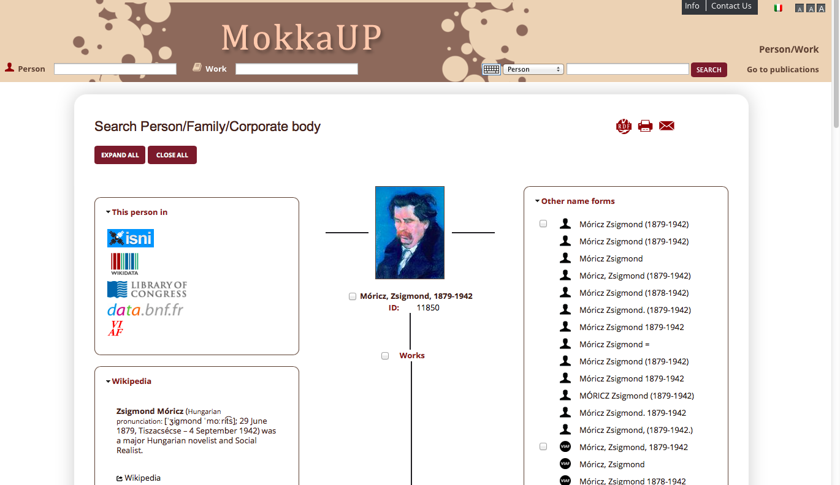
Hungarian Catalogue In FRBR Structure,
BIBFRAME Data Format MOKKA UP - @cult

Slide 30
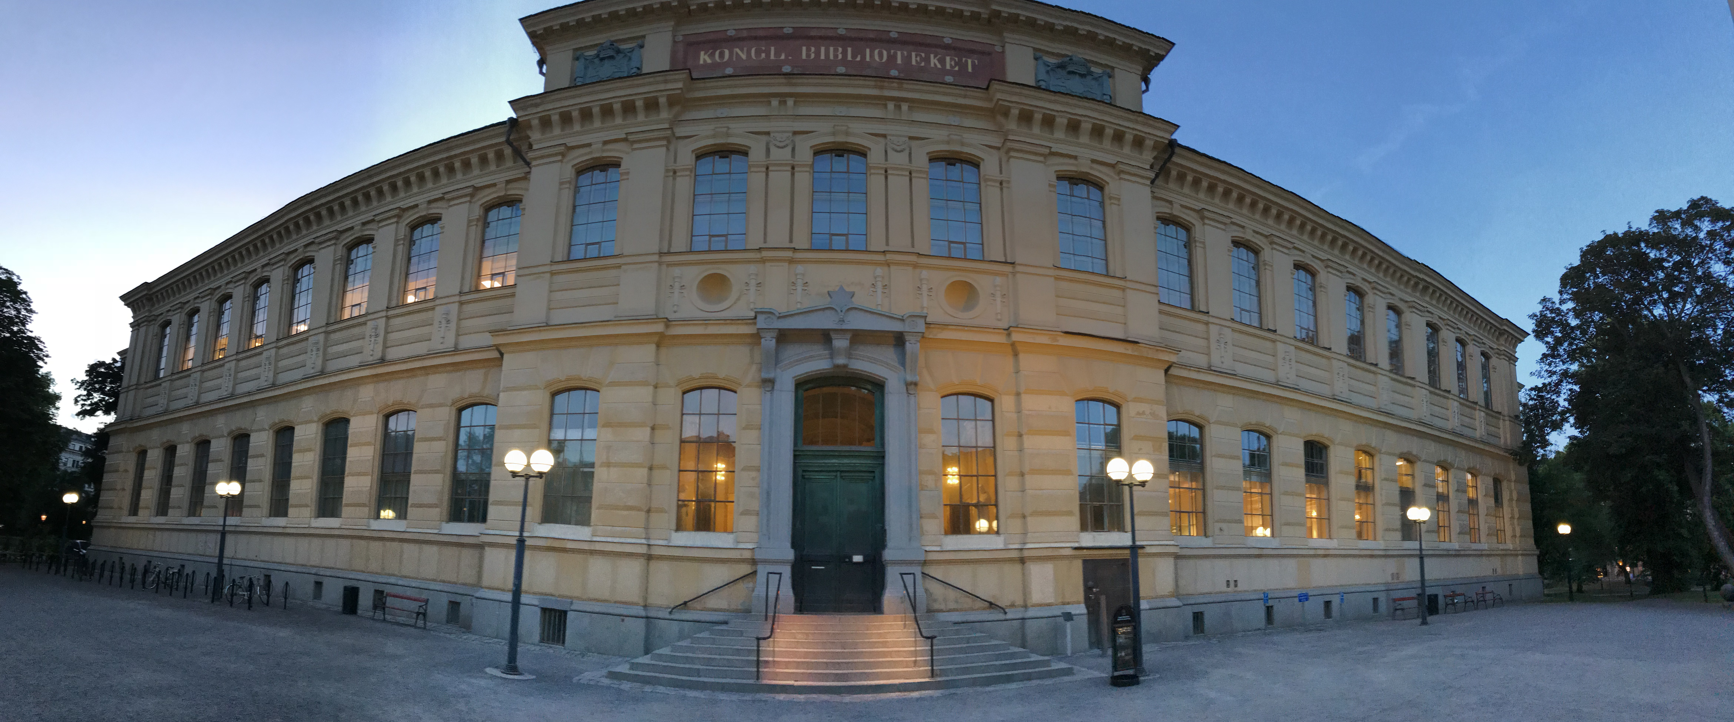
  Swedish National Catalogue in BIBFRAME
  11th June 2018
  for BIBFRAME conversion
ational Catalogue In BIBFRAME Format, June 11, 2018

Slide 31
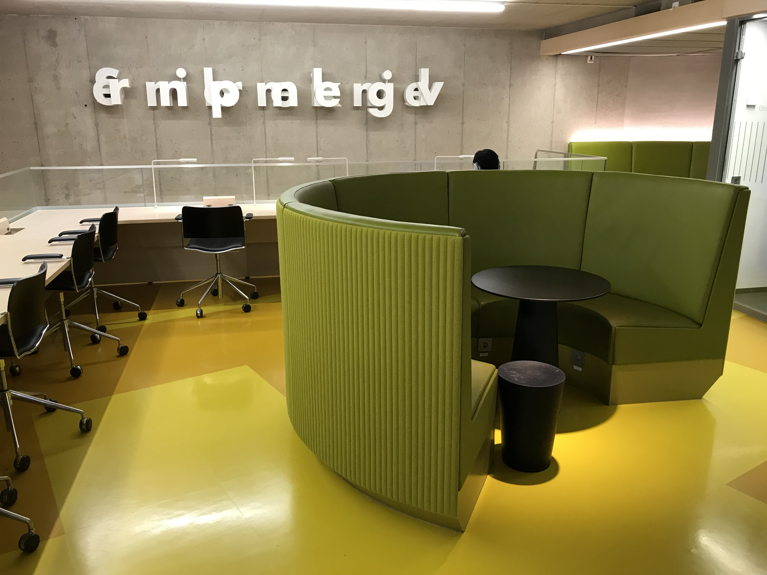
SHARED
FRAMEWORK
SOFTWARE CODE
VOCABULARIES
DATA
IDEA
COPYRIGHT INFORMATION

Slide 32
SHARED
CATALOGING
DIGITISATION
STATEMENTS
VARIATIONS
RESPONSIBILITY
PROCESSING

Slide 33
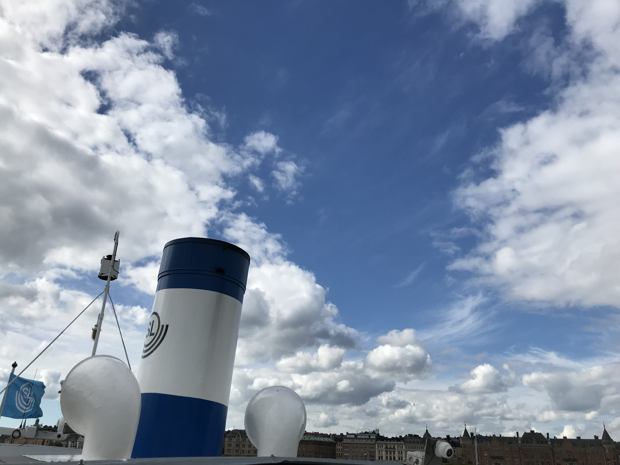
FOLIO ADDITIONAL FUNCTIONS
QUALITY LEVEL
CHOICE OF MODULES AND FORMATS
MUSEUM, ARCHIVE CONNECTION
FLEXIBLE PARAMETERISABLEWORKFLOWS
ARTIFICIAL INTELLIGENCE
EDITORIAL SYSTEM
PARAMETER-DRIVEN INDIVIDUAL SKIN

Slide 34
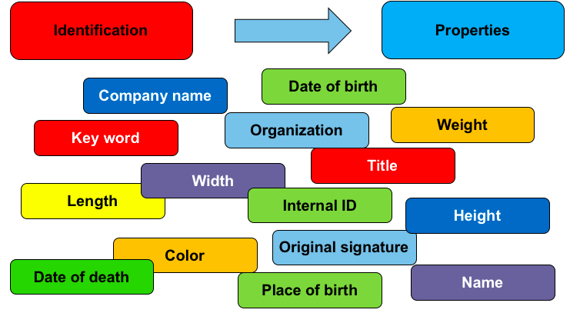
  Properties
Source / Copyright: Her-Mész Soft

Slide 35
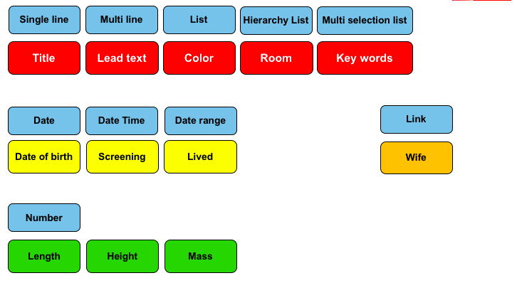
  Data Grouped According Content
Source / Copyright: Her-Mész Soft

Slide 36
  Special Collections And Knowledge Representations
Attributes
Schema
A:Digital Collection
AttributeTypes
A Obj:Person
B Obj:Person
Single Line
Multi Line
Date
DateTime
Selection List
HierarchySelection
Number
Date range
Relation
Att:Name
Obj:Person
Single Line
C Obj:Picture
Name
Single Line
Att:Birth
B:Digital Collection
Birth
Date
A Obj:Person
Date
Att:Width
B Obj:Letter
Number
Obj:Picture
C Obj:Picture
Att:Source
Width
Number
C:Digital Collection
Selection list
Source
A Obj:Person
Selection list
B Obj:Event
C Obj:Anything
Source / Copyright: Her-Mész Soft

Slide 37
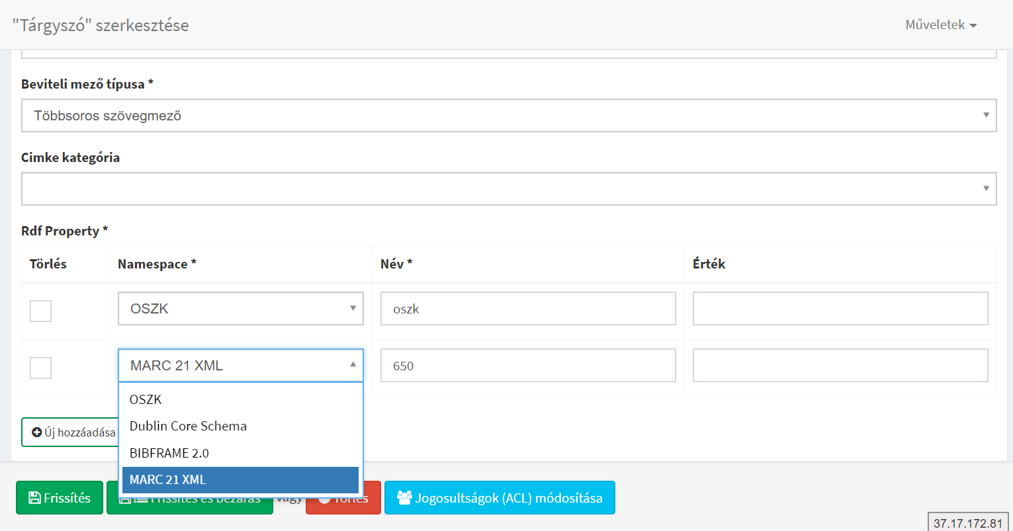
  Schema Definition Attribute - compatibility
Source / Copyright: Her-Mész Soft

Slide 38
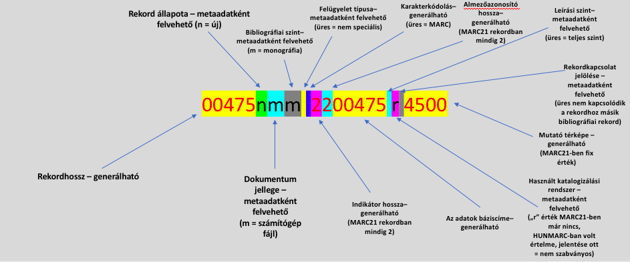
  MARC21 000 – Record Heading
Source / Copyright: Her-Mész Soft

Slide 39
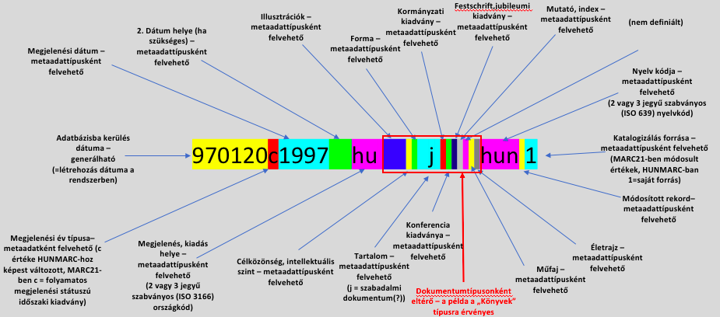
  MARC21 008 – Data Elements With Fix Length
Source / Copyright: Her-Mész Soft

Slide 40
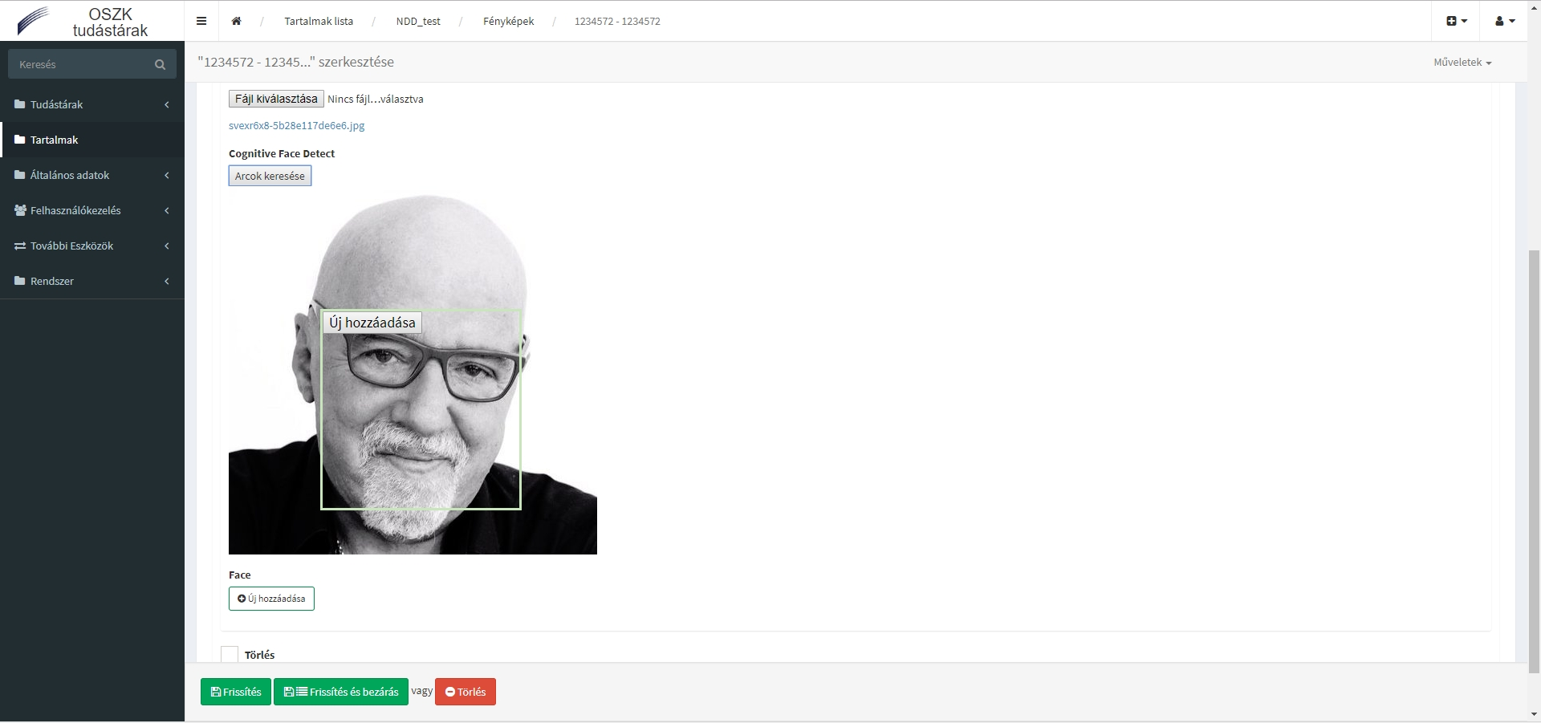
  Artificial intelligence – face recognition
Source / copyright: Her-Mész Soft

Slide 41
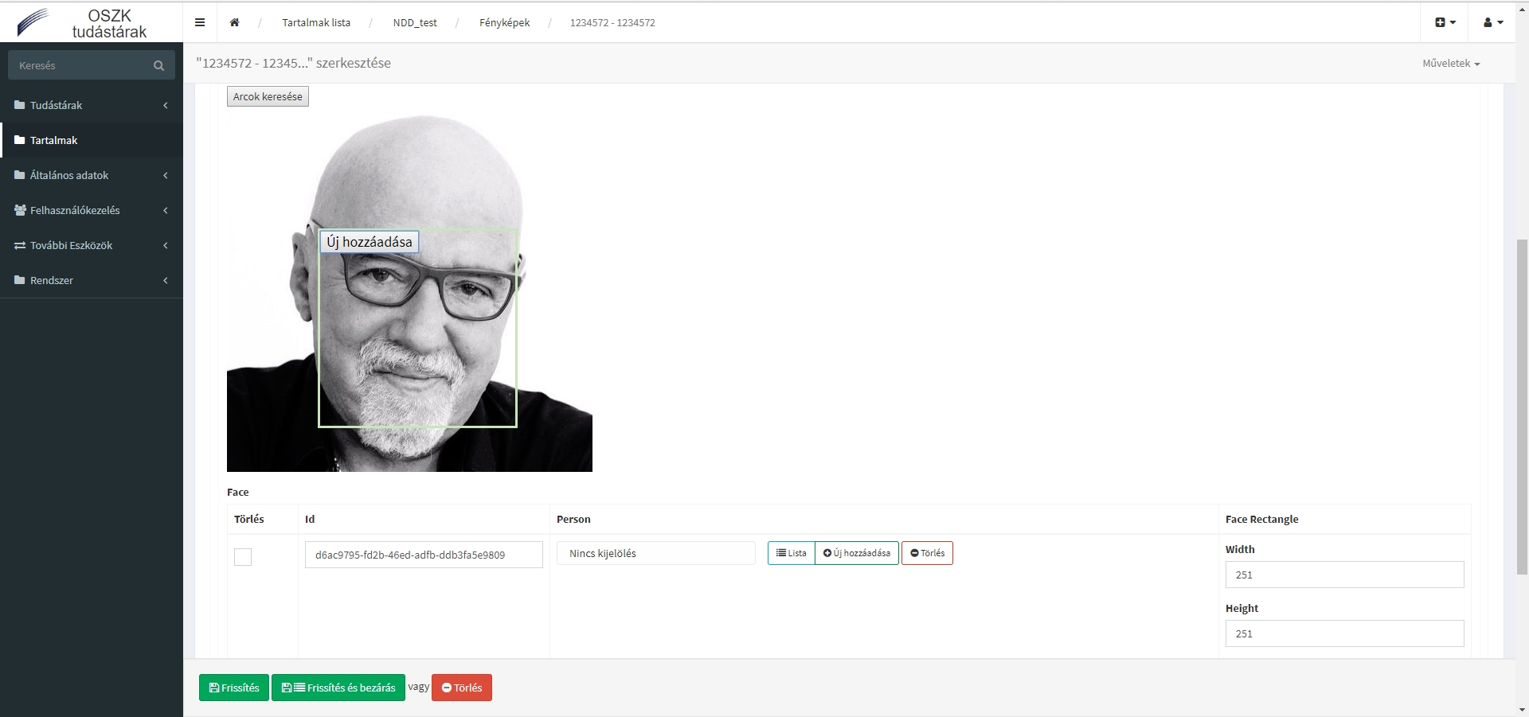
  Teaching the machine – adding a name / ID
Source / copyright: Her-Mész Soft

Slide 42




  Arctic World Archive

Slide 43
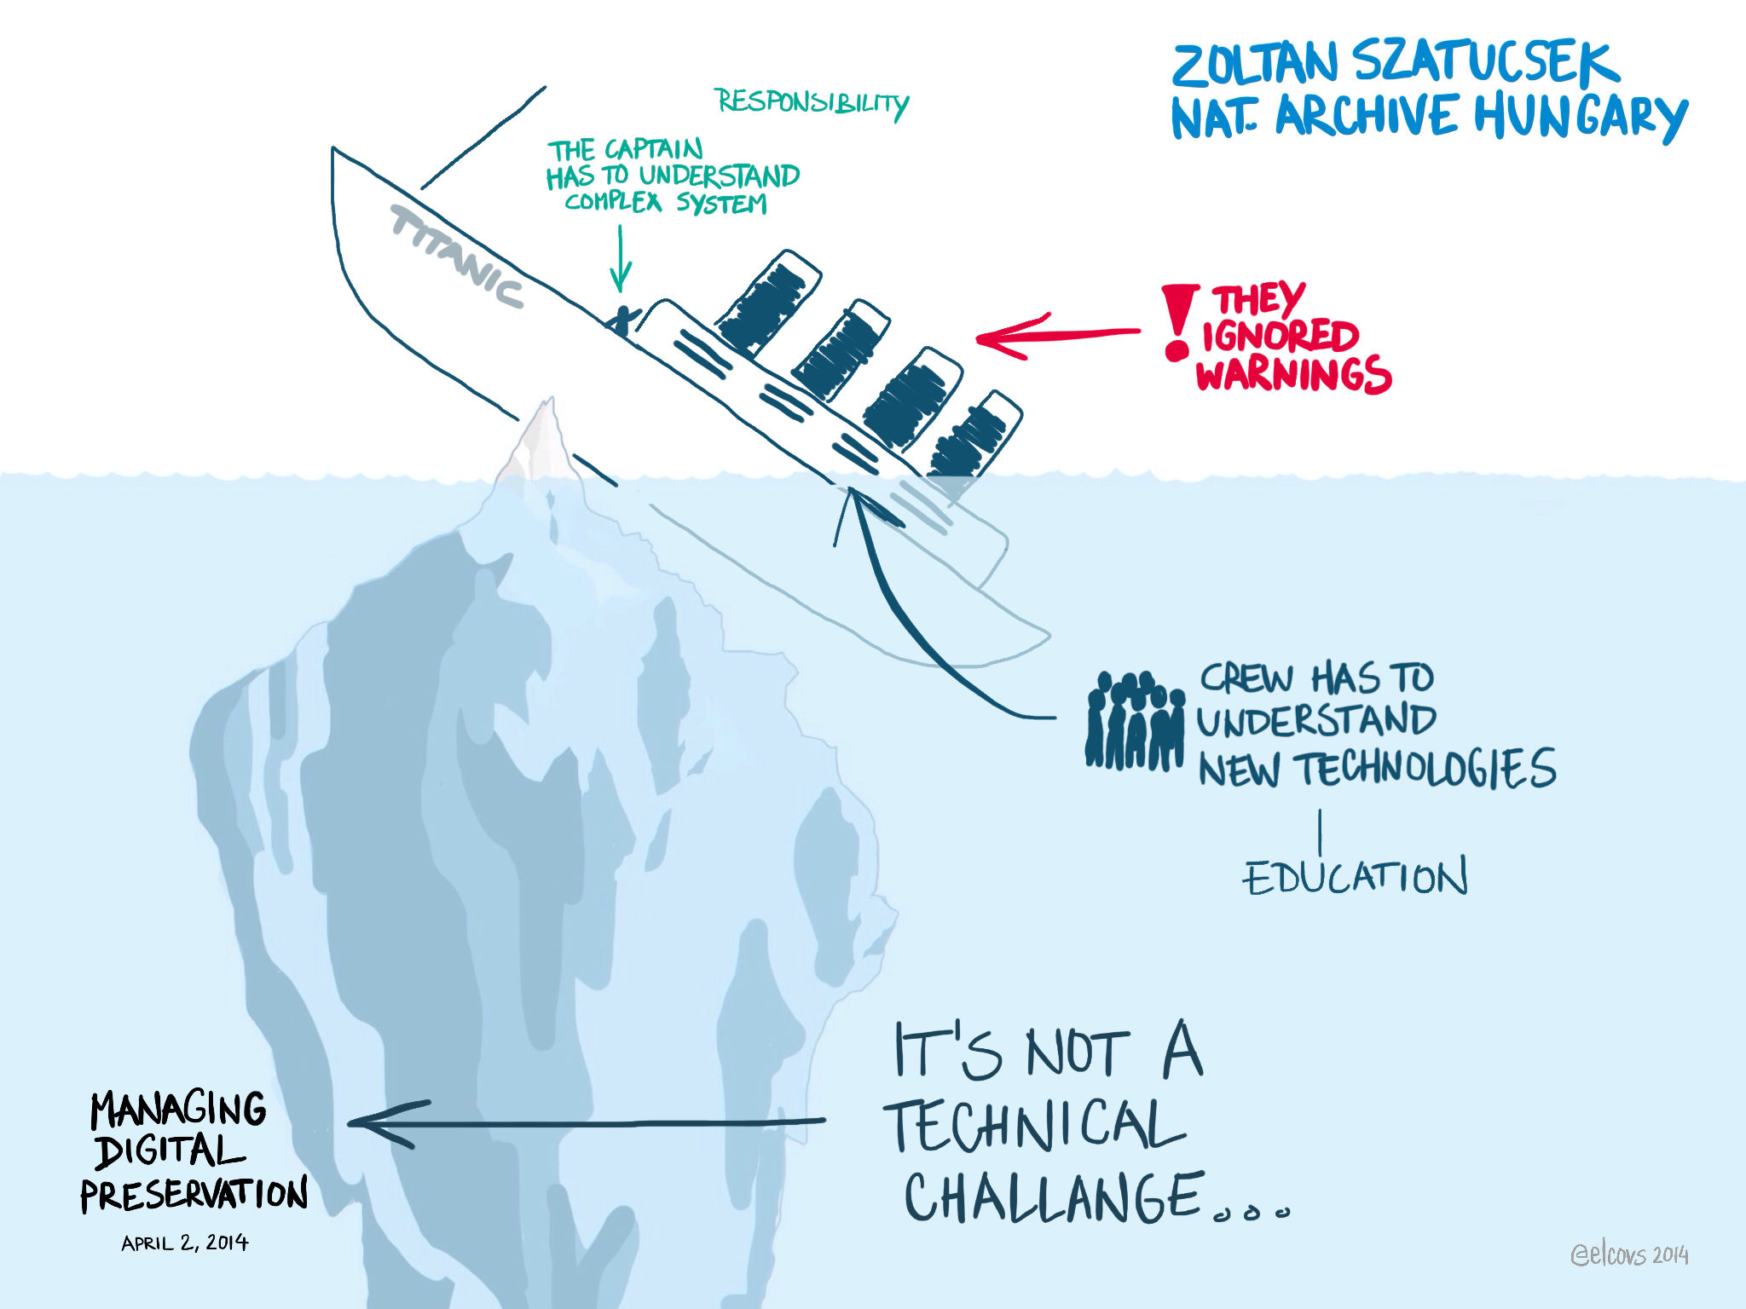

Slide 44
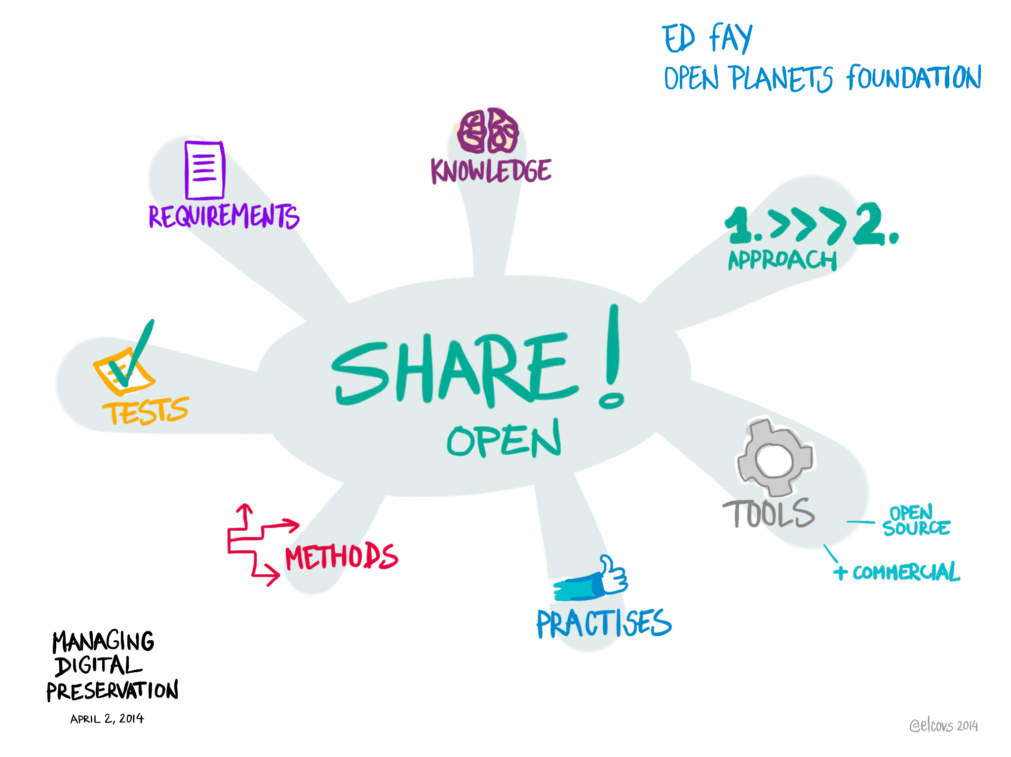
  Managing Digital Preservation

Slide 45
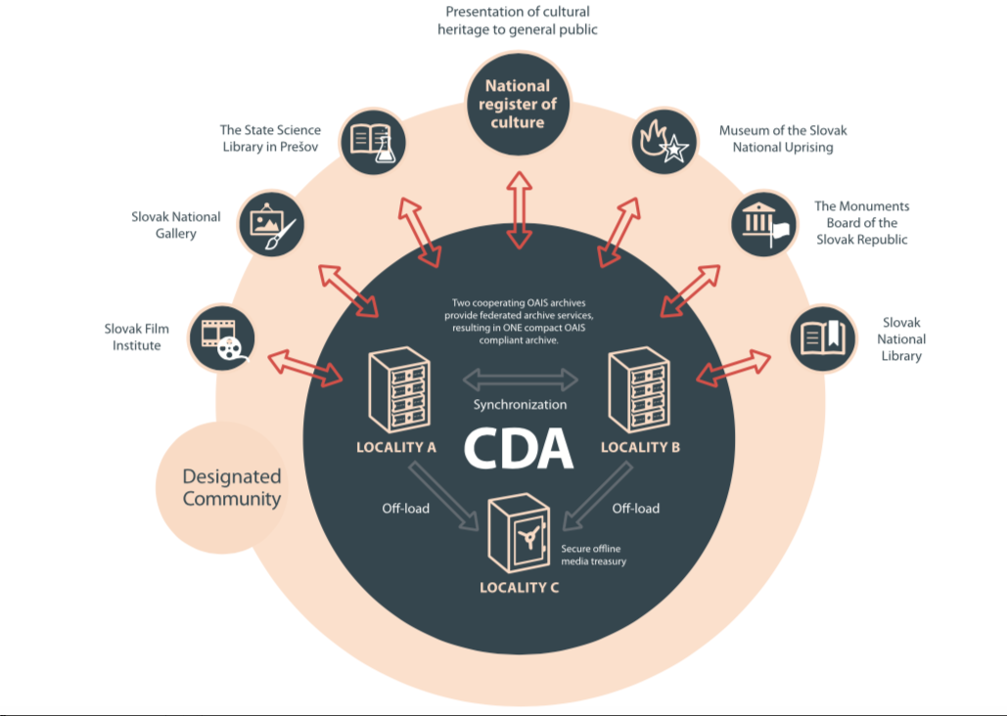
  Central Data Archive Slovakia
Source: web

Slide 46
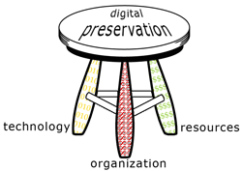

Slide 47

If you want to save it,
share it!
Classified
Identified
Authenticated
Reliable Data
Transparent
Shared
Available
Free
Source:

Slide 48

The Future of Libraries is Open, and It Is Up To Us!
www.oszk.hu , lendvay.miklos@oszk.hu

