Slide 1
14:30
Your archiving and preservation requirements and solutions
Arkivum

Slide 2
Arkivum brings archived data to life

Slide 3
What are your requirements?
Motivations…
Protection?
Access?
Reputation?
Generate income?
Save staff time?
Comply with regulations?
... All of these?!!

Slide 4
What do I archive?
Data types: file formats
Different collections
Different locations / departments
Digitized items
Born-digital (digital native) items

Slide 5
Working with Arkivum
What does an archiving project involve?
Business Case / proposal
Scope and planning
Requirements gathering
Project Management
UAT
Go Live
Customer Success

Slide 6
OAIS (Open Archival Information System) Model (ISO14721:2003)

Slide 7
Solution Overview
Easy to use, single interface for automatic preservation & archiving
Partner focused
Built on open standards
Full managed service – we give you advice, help & guidance
100% data integrity guarantee
Integrates with existing systems
Exit plan
Arkivum understands you…
Why choose Arkivum?

Slide 8
TATE Britain
London, UK
The world centre for the study and display of British art
On-premise deployment (across 3 Tate locations)
End-to-end solution: remotely manage, safeguard and replicate digital assets within Tate
Not a single bit lost
Safeguarding thousands of items being digitised as part of the Archives & Access project
5 YR
52,000
100%
>80 TB
Contract duration
Items being safeguarded
Data integrity guarantee
Projected
storage capacity

Slide 9
University of Westminster
London, UK
Founded in 1838, the oldest polytechnic institution in the UK
Hybrid solution; on-premise and hosted
Full Perpetua suite adopted module by module
Highly valuable collections data and institutional records
Digitised and born-digital data secured, preserved and made accessible
175 YR
14
0
3
Age of
collection
References
given
Bits lost
Modules adopted

Slide 10
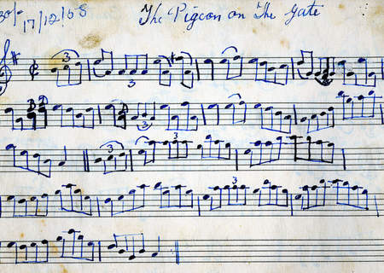
ITMA – Irish Traditional Music Archive
Dublin, Ireland
Premier centre for the study of Irish Music
Fully hosted solution
OAIS compliant digital preservation technology
Needed an easy and intuitive search mechanism for wide range of users
Arts Council Funded
30 YR
3 YR
24TB
1854
Contract
length
ITMA has existed for
Current collection size
Date of oldest digitzed item

Slide 11
Solution Demo

